Slide 1

Prophet-Based Weather Forecasting
Prepared by,
1.Mohammed Akram T.K - 160520733006
2. Mohammed Bilal - 160520733020
3.Fuzail Rahman Baig - 160520733026

Slide 2
Abstract
Weather forecasting plays a vital role in aiding people's planning and various primary sectors, such as farming, which heavily relies on weather conditions. With climate change accelerating, traditional prediction methods face challenges. To address this, our focus is on implementing an improved and reliable weather forecasting system using machine learning techniques. The project aims to develop a weather forecasting system that utilizes science and technology to predict atmospheric conditions for specific locations. By analyzing temperature, humidity, precipitation, and wind parameters, users can access accurate weather forecasts based on historical data from a comprehensive database. The system's goal is to provide reliable predictions, with potential applications in Air Traffic, Marine, Agriculture and other industries, supporting decision-making processes and optimizing operations. The success of machine learning in this domain depends on data quality, algorithm selection, and prediction system design. This abstract emphasizes the potential of machine learning in weather forecasting and the dedication to enhancing its accuracy and reliability.

Slide 3
Introduction
Weather prediction has undergone a significant change with the inclusion of machine learning, using artificial intelligence algorithms to anticipate upcoming weather situations.
This modern approach includes training machine learning models on past weather information to understand the complex connection between atmospheric factors and evolving weather trends.
The main challenge tackled by machine learning-based weather prediction is to create a strong system that can precisely forecast future weather conditions using both previous data and present environmental conditions.
This forecast model is then used to make predictions based on current weather conditions and emerging tendencies.
The use of machine learning in weather prediction provides a range of benefits, including improved precision, quicker processing, and the ability to skillfully handle intricate datasets.
This project sets out to demonstrate the effectiveness of analyzing time-series data combined with the advanced Prophet model, contributing valuable insights into the fundamental patterns and trends embedded within weather data.

Slide 4
Existing System
Traditional weather prediction relies on vast datasets processed by supercomputers.
Numerical computations of multiple physical processes lead to forecasts taking hours to generate.
Google uses a "data-driven physics-free approach" with radar images and CNNs to predict weather.
This approach treats weather prediction as an image-to-image translation task.
It doesn't rely on atmospheric conditions or physics-based models.
The challenge lies in accurately translating radar data into meaningful weather forecasts.

Slide 5
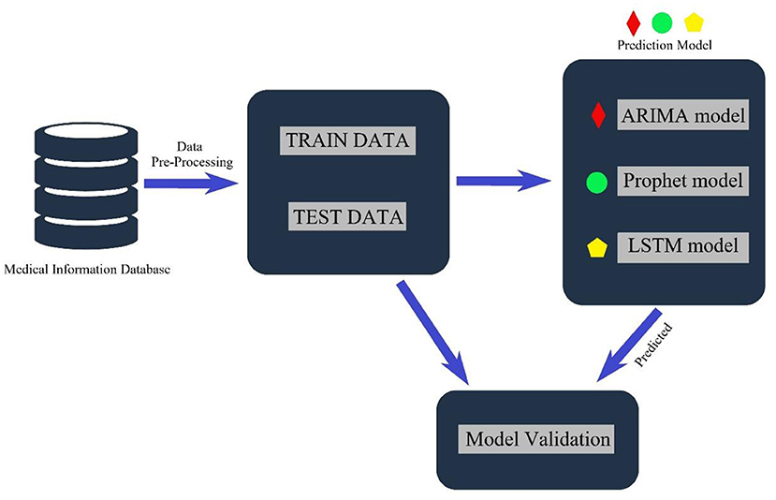
Proposed System
The proposed weather forecasting system, built around the Prophet model, capitalizes on cutting-edge advancements in time series forecasting, promising precise and dependable weather predictions.
Key Points from the Proposed System:
Data Collection: Gather from weather stations, satellites, and agencies.
Model Training: Train Prophet model with advanced ML algorithms.
Forecast Generation: Predict future weather based on historical data and trends.
Continuous Improvement: Regular updates and retraining for enhanced accuracy.
Benefits:
Improved Accuracy
Real-time Insights
Adaptability
User Accessibility
Objective:
Enhancing weather forecasting through ML for precise, real-time predictions.

Slide 6


SYSTEM REQUIREMENTS
Hardware Requirements:
Standard Personal Computer
Adequate RAM and Processing Power for Data Handling
Display Monitor for Visualization
Software Requirements:
Jupyter Notebook Environment
Python Programming Language
Prophet Forecasting Model Library
Data Preprocessing Libraries (e.g., Pandas)
Data Visualization Libraries (e.g., Matplotlib, Seaborn)
Necessary Data Collection and Analysis Tools

Slide 7
Methodology of Implementation
Load in and clean the data
Define targets and predictors
Train model
Scale model to entire dataset using cross-validation
Make future predictions

Slide 8
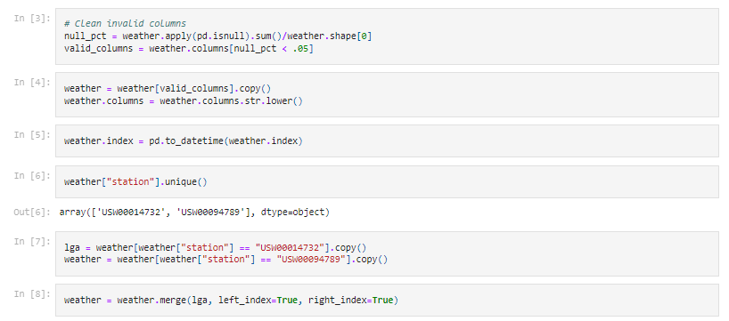
Load in and clean the data

Slide 9
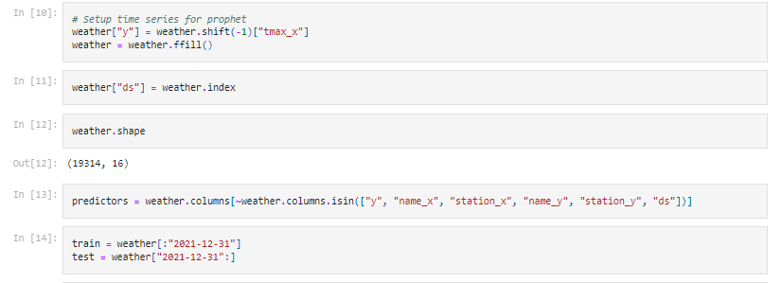
Setting Time series for Prophet Model and training it

Slide 10
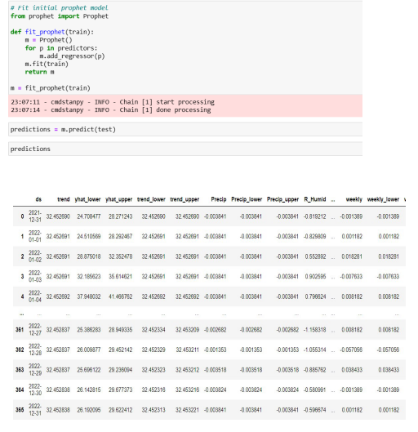
Fitting the prophet model and Making Prediction

Slide 11
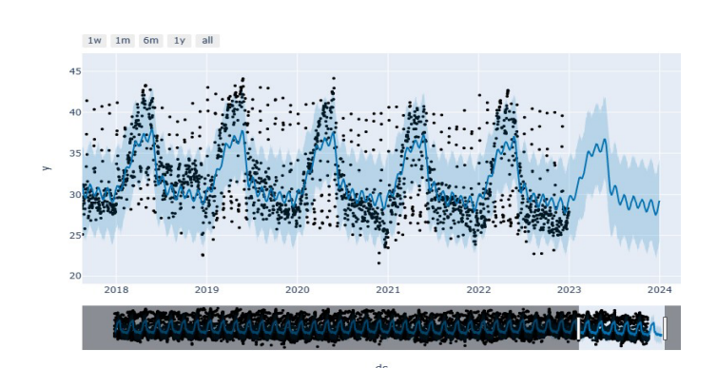
Result Analysis
1.Predicting the weather for a given date.
2.Using Prophet model we can predict weather for multiple days and even years into the future.
3.We can obtain the trend of the weather from this ML model.
4.This project can be used to forecast weather instead of existing system.

Slide 12
Extreme Event Prediction: Develop specialized models to predict rare and extreme weather events, aiding in disaster preparedness. Interdisciplinary Collaboration: Collaborate with domain experts, climatologists, and environmental scientists to enrich models with domain-specific insight Automated Data Collection: Implement AI-powered systems to automatically collect and preprocess data, reducing human intervention and errors. Real-time Data Streaming: Utilize AI to process and analyze real-time data streams, enabling up-to-the-minute forecasts. Continuous Model Learning: Develop models that can learn and adapt to evolving weather patterns over time, ensuring sustained accuracy. Explainable AI: Integrate explainable AI techniques to provide insights into why specific forecasts are generated, enhancing model transparency. Hyper-localization: Implement AI techniques to provide highly localized forecasts, incorporating microclimate data and urban heat island effects. By pursuing these avenues of enhancement, this weather forecasting project can evolve into a cutting-edge platform, providing even more accurate, timely, and valuable insights to users.
Future Enhancements

Slide 13
Conclusion
Machine learning has been applied in various forms to weather forecasting, and its results have been shown to be promising in some cases.
However, weather forecasting is a complex problem, and the accuracy of machine learning models can still be improved.
Additionally, machine learning models for weather forecasting typically require large amounts of data and computing resources, and their predictions can still be subject to errors and biases.
Overall, machine learning has shown potential for improving weather forecasting, but there is still room for further research and development.

Slide 14
REFERENCES:
Dataset:
The dataset is taken from NASA power access
viewer.
Research Paper (IEEE):
“Monthly Rainfall Prediction Using the Facebook Prophet Model for Flood Mitigation in Central Jakarta” by Andi Sulasikin and Alex Lukmanto Suherman

